Slide 1
Understanding PEP 8
• PEP 8: Python Enhancement Proposal for style guide
• Promotes readability and consistency
• Covers code layout, naming, imports, whitespace, etc.
• Encouraged by Python community and tools (e.g., flake8, pylint)

Slide 2
Indentation, Comments, and Naming
• Indentation: 4 spaces (no tabs)
• Comments: explain 'why', not 'what'
- Inline: # comment
- Block: use full sentences
• Naming Conventions:
- Variables/functions: snake_case
- Classes: CamelCase
- Constants: UPPER_CASE

Slide 3
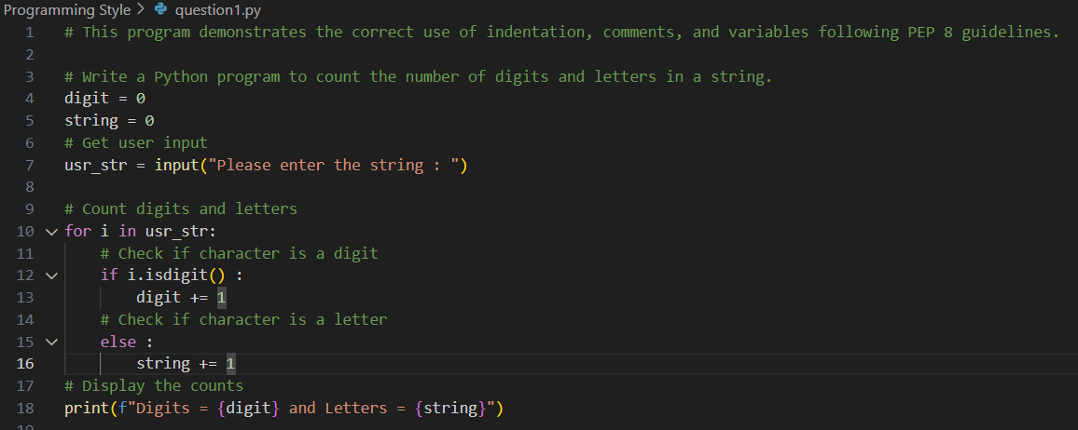
Writing Readable Code
• Keep lines short (< 79 characters)
• Use blank lines to separate logical sections
• Use descriptive names for variables and functions
• Break complex expressions into simpler parts
• Write self-explanatory code over excessive comments

